Slide 1
Lecture 2: Elements of Decision Problems – Structuring Decisions
Yeganeh M. Hayeri
SYS 660
Spring 2019

Slide 2
Today’s Lecture
Alaskan Pipelines – Challenger - Exercise
The Decision Analysis Process
Net Present Value
Scales
Structuring Decisions

Slide 3
The Decision Analysis Process
Decision Analysis Process Flow Chart*
Identify the decision situation and understand objectives
Identify Alternatives
Process is nominal.
Real life is “messy”.
Jumping back and forth and iterating are common.
Sometimes it is better to start with understanding the problem and other times it is better to start with understanding the objectives.
The decision analysis process is a useful guide to bring some structure to what is often an ad hoc process.
Decompose and model the problem:
Model of problem structure
Model of uncertainty
Model of preferences
Choose the best alternative
Sensitivity Analysis
Is further analysis needed?
Yes
No
Implement the chosen alternative
*Clemen, R. T. and T. Reilly, 2014, Making Hard Decisions, 3rd Ed., Mason, OH: South-Western.

Slide 4
Understand the Decision Context
What is the problem that you are trying to solve?
This is not as trivial as it may seem. Solving the wrong problem is VERY common.
Understanding your objectives and values may help you refine your understanding of the problem.
What if your problem is that your software testing is finding too many bugs?
One solution is to perform less software testing!
This actually happens…
If your objective is to deliver a reliable software product, then you are solving the wrong problem!

Slide 5
Identify Alternatives
“Don’t jump to solutions!”
Deliberately trying to generate creative alternatives may substantially improve your outcomes.
This is especially critical in multi-stakeholders where the preferred solution is a “non-starter” with a particular stakeholder.
Real life example:
An engineering team on an IT project produced an initial design that was far too expensive
The engineers had basically selected the “best” type of each component without considering other approaches
Consequently, the engineering team was given a design to cost target much lower
They found that by considering alternative equipment they could still meet all of the customer’s requirements at a substantially lower cost

Slide 6
Model the Decision
Major components:
Identify the relevant factors and relationships between them
Develop a model of the uncertainties involved
Develop a model of the decision maker(s) preferences
Evaluate each of the alternatives using the model
The art of modeling is knowing what to simplify and how
The models don’t have to be mathematical, but mathematical models are more amenable to analysis
The majority of this course will be spent on modeling decisions and risks

Slide 7
Sensitivity Analysis
Sensitivity analysis is avoided at your peril
What if a slight change in the value of a parameter triggers a completely different decision?
Sensitivity analysis lets you understand how robust your solution is
It also helps you identify areas that require more investigation
For example, if sensitivity analysis reveals that your decision to move forward with a new product launch hinges on the likelihood of your competitor releasing a similar product, it is in your best interest to invest some effort in understanding your competitor’s situation

Slide 8
More Analysis?
The decision analysis process may result in:
A refined understanding of problems and objectives
The identification of additional alternatives
A shift in the decision maker’s preferences
Areas that require more investigation
Consequently, the process may take several iterations to reach a final decision
Ideally, the result will be not only a good decision but also a well-supported one

Slide 9
Net Present Value

Slide 10
Time Value of Money
Money today is worth more than money tomorrow.
You could invest money today and receive a return on that investment tomorrow.
For example, imagine that there is an investment opportunity that will cost you $1 today, but you will get $2 tomorrow, risk-free.
If I were to offer you the choice of $1 today or $1 tomorrow, which would you prefer?
In essence, you are concerned about the opportunity cost of deferring cash flows.

Slide 11
Time Value of Money
Accounts for time value of money when considering multiple cash flows over multiple years.
Two questions:
1- If I give you a dollar today, what will it be worth x years in the future? (compounding)
2- Given a dollar held or spent x years in the future, what is it worth in today’s dollars (discounting)

Slide 12
Basic Compounding Formula
FV = PV (1+i)^{n}
Where:
FV = Future value
PV = Present value
i = Interest rate
n = Number of years

Slide 13
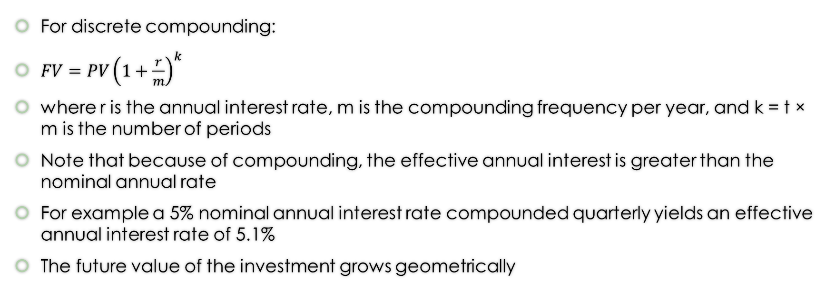
Compound Interest
For discrete compounding:
$FV=PV{\left(1+\frac{r}{m}\right)}^{k}$
where r is the annual interest rate, m is the compounding frequency per year, and k = t × m is the number of periods
Note that because of compounding, the effective annual interest is greater than the nominal annual rate
For example a 5% nominal annual interest rate compounded quarterly yields an effective annual interest rate of 5.1%
The future value of the investment grows geometrically

Slide 14
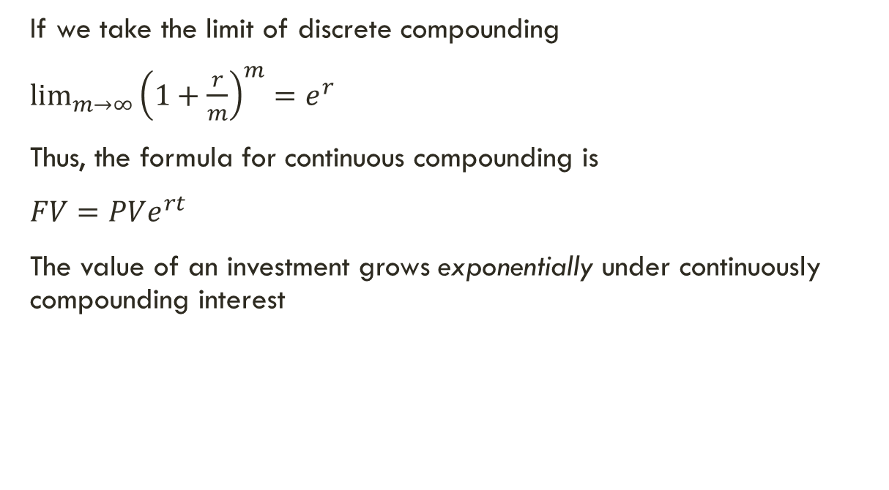
Continuously Compounded Interest
If we take the limit of discrete compounding
$\lim_{m→∞}{{\left(1+\frac{r}{m}\right)}^{m}}=e^{r}$
Thus, the formula for continuous compounding is
$FV=PVe^{rt}$
The value of an investment grows exponentially under continuously compounding interest

Slide 15
Basic Discounting Formula
PV = FV[1/ (1+i)^{n}]
Where:
FV = Future value
PV = Present value
i = Interest rate
n = Number of years

Slide 16
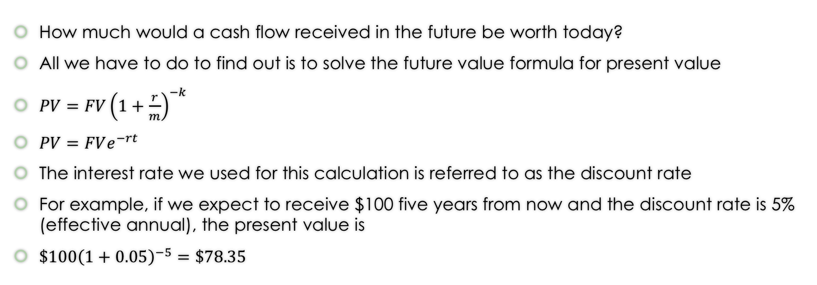
Present Value
How much would a cash flow received in the future be worth today?
All we have to do to find out is to solve the future value formula for present value
$PV={FV\left(1+\frac{r}{m}\right)}^{−k}$
$PV=FVe^{−rt}$
The interest rate we used for this calculation is referred to as the discount rate
For example, if we expect to receive $100 five years from now and the discount rate is 5% (effective annual), the present value is
$\$100{\left(1+0.05\right)}^{−5}=\$78.35$

Slide 17
Think about this …
$1 today $1.10 in 1 year
$1 today $1.10 in 1 year
Assuming 10% interest
$0.91 today $1 in 1 year
Notes:
How about 5 years:
$ 1 today = $1.61
$1 in five years = $0.62

Slide 18
Discounting Assuming 10% Interest Rate

Slide 19
What is the purpose of discounting?
Discounting is used to adjust future, or actual dollars expended or earned/saved over multiple years to constant or base-year dollars (typically today’s dollar). This helps a decision maker with fair comparison of all revenues and costs for all alternatives being considered.

Slide 20
Application
Imagine winning the State lottery and being faced with this choice:
Take a lump sum payout (today) of $50 million
Take a twenty-year annuity of $5 million per year for 20 years
Assume 10% discount rate

Slide 21
Application
$1,000 investment (up front)
Net cash inflow of $500 per year over the following 5 years
Cost of capital is 12% (also known as discount rate, required rate of return)

Slide 22
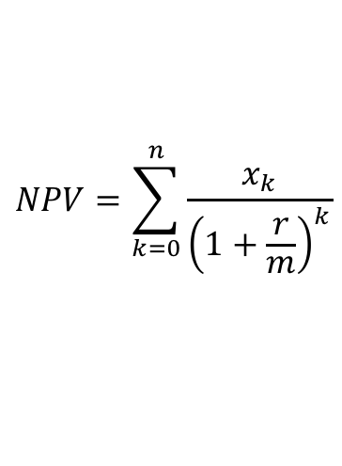
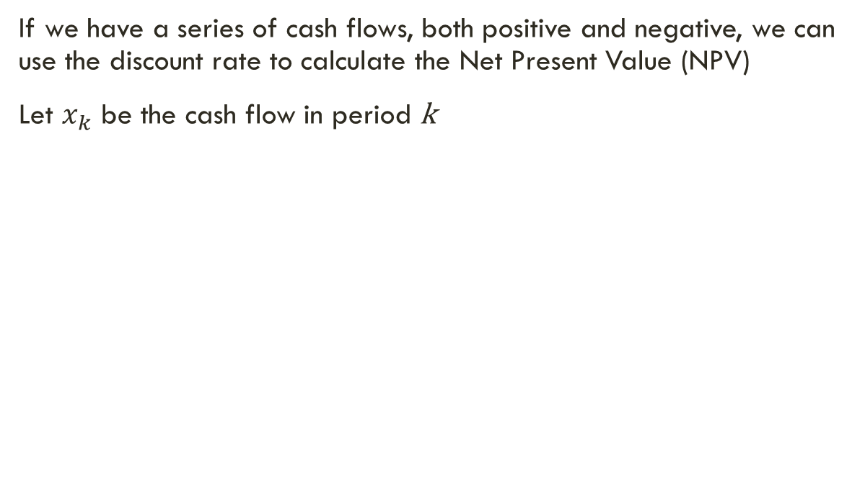
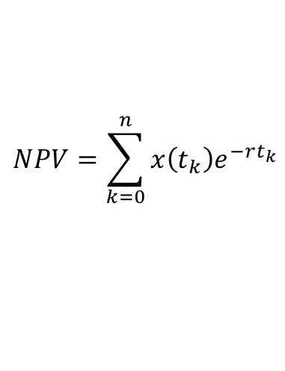
Net Present Value
If we have a series of cash flows, both positive and negative, we can use the discount rate to calculate the Net Present Value (NPV)
Let $x_{k}$ be the cash flow in period k
$$NPV=\sum_{k=0}^{n}{\frac{x_{k}}{{\left(1+\frac{r}{m}\right)}^{k}}}$$
$$NPV=\sum_{k=0}^{n}{x\left(t_{k}\right)e^{−rt_{k}}}$$

Slide 23
Net Present Value
Net Present Value (NPV) is critical for investment decisions
Generally speaking, given a set of possible investments, you should choose the investment that has the highest NPV
NPV is a standard criterion for business decision making
The catch, of course, is setting the right discount rate
Determining the appropriate discount rate is non-trivial and it is a key aspect of financial theory
We will discuss discount rates more when we discuss financial risk

Slide 24
Measurement Scales

Slide 25
Measurement Scales
Nominal
Items can be grouped but there is no relationship between the groups
For example, grouping items by color: red, green, blue, yellow, etc.
Ordinal
Items can grouped by order, but we cannot say how much greater one group is than another
For example, alphabetical order: A, B, C, D or star ratings of restaurants (2-star, 3-star, etc.)

Slide 26
Measurement Scales
Interval
Items can be measured quantitatively, but only the differences between measurements are meaningful
For example, altitude above sea level
Ratio
Both differences and ratios are meaningful. the scale has a true zero point
For example, height and weight

Slide 27
Mathematical Rules
The nominal scale is considered qualitative while the remainder are considered quantitative
You cannot perform arithmetical operations on ordinal scales
The difference between ordinal numbers is NOT meaningful
Performing arithmetical operations on ordinal numbers is a very common mistake in decision and risk analysis
You can only perform addition and subtraction on interval scales
Ratios of interval scaled numbers are NOT meaningful
You can perform all arithmetic operations on ratio scaled numbers
Since ratios are meaningful, you can perform addition, subtraction, multiplication, and division

Slide 28
Interval Scale Example
Imagine that you are standing 10 meters below sea level
Imagine that your friend is standing 10 meters above sea level
This means that your friend is 20 meters higher than you
However, your friend is not -1 times higher than you
Since altitude above sea level does not have a true zero point, the intervals are meaningful but the ratios are not
This is an example of an interval scale

Slide 29
Ratio scale example
Imagine that you measure the temperatures of two different containers of liquid
The temperature of the first container is 100K and the temperature of the second container is 200K
Both are very cold!
You can say that the temperature of the second container is 100K greater than the first
You can also say that the second container is twice as hot as the first
Temperature in Kelvin has a true zero point so ratios are meaningful
This is an example of a ratio scale

Slide 30
Modeling a Decision

Slide 31
Model
A model is a physical, mathematical or logical representation of a system, entity, phenomenon, or process. There is no movement in a model. Think of a plastic replica of an airplane or a car, or a mathematical equation that predicts the probability of an event occurring.
Source: Farr -2007 – Chapter 1

Slide 32
Modeling Decisions
Value
Objective
An objective is a specific thing that you want to achieve.
An individual's objectives taken together make up his or her values.
A person's values are the reason for making decisions in the first place!

Slide 33
Boeing Example - Objectives

Slide 34
Structuring Decisions
List your objectives
Prioritize into fundamentals vs. means

Slide 35
Fundamental Objectives Hierarchy
Increase Lifetime Earnings
Increase Current Salary
Marry Rich
Go to School
Undergrad
Grad School
Find New Job
Get a Raise
Update Resume
Network
Do a Better Job

Slide 36
Structuring a Decision
All about the objectives (what you want to achieve)
Decision: choice between options
There is always an option, including status quo
Waiting for more information also an option
Uncertainty: always exists
Outcomes: possible results of uncertain events
Many uncertain events lead to complexity

Slide 37
Structuring a Decision
Elements of smart choices
Separating means and fundamental objectives
Getting the decision context right
Generating alternatives
Influence diagrams and decision trees

Slide 38
Elements of Smart Choices
Problem: Work on the right decision problem
Objectives: Specify your objectives
Alternatives: Create imaginative alternatives
Consequences: Understand the consequences
Tradeoffs: Grapple with your tradeoffs
Uncertainty: Clarify your uncertainties
Risk Tolerance: Think hard about your tolerance
Linked Decisions: Consider linked decisions
*Hammond, J.S., Keeney, R.L., & Raiffa, H. (1999). Smart Choices: A Practical Guide to Making Better Decisions. Boston, MA: Harvard Business School Press.
Notes:
Hammond, J.S., Keeney, R.L., & Raiffa, H. (1999). Smart Choices: A Practical Guide to Making Better Decisions. Boston, MA: Harvard Business School Press.

Slide 39
Identifying Objectives
Write down all the concerns you hope to address through your decision
Convert your concerns into succinct objectives
Separate ends from means to establish your fundamental objectives
Clarify what you mean by each objective
Test your objectives to see if they capture your interests
Notes:
Source: William B. Rouse, ISYE 6223, 2010

Slide 40
Separating Ends and Means
What is wrong with using a “means” objective in place of an “ends” objective?
Risk of solving the wrong problem
Risk of artificially restricting the set of alternatives
However, exploring means and their relationship to ends can generate a tremendous amount of insight
In some circumstances, a means objective may be substituted for an ends of objective because it may be more amenable to measurement
Should be a conscious decision that is based on an thorough understanding of the risks

Slide 41
Example: Improving Decision Making
Ends Objective: Improve your decision making at work
Means Objective: Get an ‘A’ in SYS 660
Solving the wrong problem:
You might be able to get an ‘A’ in the class by cheating, but then you would not understand decision analysis well enough to your improve decision making at work
Restricting the set of alternatives
Taking SYS 660 may not be the only way to improve decision making at work
Other alternatives: find a mentor at work who is an effective decision maker, read books on decision analysis on your own, hire a consultant, etc.
Taking SYS 660 may still turn out to be the best alternative, but you don’t want to artificially restrict the set of potential alternatives
For example: What if you took a decision analysis course in the past, and you just need to brush up? Perhaps reading some books would be a good alternative.

Slide 42
Fundamental Objectives Hierarchy
Minimize Hurricane Impacts to City
Explain
Minimize Loss of Life
Minimize Property Damage
Minimize Lost Economic Activity
Minimize Recovery Time
Objectives to trade

Slide 43
Means Network
Minimize Hurricane Impacts to City
Maximize Flood Controls
Maximize Warning Time
Minimize Infrastructure in Flood Prone Areas
Maximize Emergency Response Capability
Build Flood Gates and Flood Walls
Improve Forecasting Models
Improve Personnel Training
Preposition Equipment

Slide 44
Identifying Means and Fundamental Objectives
 | Fundamental Objectives | Means Objectives
To Move: Ask: | Downward in the Hierarchy: What do you mean by that? | Away from the Fundamental Objectives: How could you achieve this?
To Move: Ask: | Upward in the Hierarchy: Of what more general objective is this an aspect? | Toward Fundamental Objectives: Why is that important? (WITI)

Slide 45
What is the Decision Context?
The decision context involves the scope and circumstances that the surround the decision
Changing the context can have an impact on the fundamental objectives hierarchy and the means network
Broadening the scope may:
Convert some fundamental objectives to means objectives
Open up additional alternatives
Consider the hurricane example: What would happen if we broadened the scope to the entire nation and/or all natural disasters?
While broadening the scope may open up additional alternatives, do we have the authority and resources to make decisions at that level?

Slide 46
Do you have the Right Context?
Does the context really capture the situation at hand?
Are you addressing the right problem?
Example: Improving hurricane warning time might not do much to reduce property damage or lost economic activity
Do you have the authority to make the decision?
If you don’t have the authority, you need to narrow the context
Example: If you are the mayor of New York City, you would not have the authority to improve federal disaster response
Do you have the time and resources to make the decision?
A decision with a broad scope may require more time and resources than you have
Example: If you expect a hurricane in three days, improving flood control infrastructure is not a viable option
*Clemen, R. T. and T. Reilly, 2014, Making Hard Decisions, 3rd Ed., Mason, OH: South-Western.
Notes:
Clemen, R. T. and T. Reilly, 2014, Making Hard Decisions, 3rd Ed., Mason, OH: South-Western.

Slide 47
Generating Alternatives
Use your objectives – ask “How?”
Challenge constraints
Set high aspirations
Do your own thinking first
Learn from experience
Ask others for suggestions
Give your subconscious time to operate
Create alternatives first, evaluate them later
Never stop looking for alternatives
Notes:
Source: William B. Rouse, ISYE 6223, 2010

Slide 48
Choices & Consequences
The real world is uncertain:
Good choices can have bad consequences
Poor choices can have good consequences
Fundamental attribution errors:
If I make a decision that results in a negative outcome, it is because I had bad luck
If you make a decision that results in a negative outcome, it is because you are incompetent
If I make a decision that results in a positive outcome, it is because I am talented
If you make a decision that results in a positive outcome, it is because you are lucky
Notes:
Source: William B. Rouse, ISYE 6223, 2010

Slide 49
Building Consequence Tables
Mentally put yourself into the future
Create a free-form description of the consequences of each alternative
Eliminate any clearly inferior alternatives
Organize descriptions of any remaining alternatives into a consequences table
Notes:
Source: William B. Rouse, ISYE 6223, 2010

Slide 50
Example: Consequence Table
Buying a new car:
 | Model A | Model B | Model C | Model D | Model E
Purchase Price | $15k | $20k | $35k | $25k | $30k
Annual Operating Cost | $1.5k | $1.7k | $2.5k | $2.2k | $3k
Seating | 5 | 5 | 8 | 6 | 4
Trunk Capacity | 12 | 14 | 20 | 16 | 10
Appearance | Low | Med | Low | Med | High

Slide 51
Overarching Issues
Uncertainty – What might happen?
Attributes – What matters?
Stakeholders – Who matters?
Support – How to inform?
Notes:
Source: William B. Rouse, ISYE 6223, 2010

Slide 52
Elements of an Influence Diagram
Decision
Represents a decision that needs to be made
Intermediate Consequence
Represents a mathematical calculation, a constant, or an intermediate consequence
Chance Event
Represents an uncertain event
Payoff
Represents a final outcome or a payoff function
Represents either the influence of one node on another or the sequence of one node before the other

Slide 53
Example Influence Diagram
Invest in Flood Controls
Note the relationship to the Objectives Hierarchy
Loss of Life
Hurricane Track and Intensity
Invest in Forecasting
Property Damage
Forecast
Hurricane Impact on City
Invest in Training
Personnel Response
Lost Economic Activity
Can you think of ways to improve this diagram?
Implement Emergency Response
Population Response
Recovery Time

Slide 54
Common Mistakes
Treating an influence diagram like a flow chart
Everything does not need to be sequenced
View the influence diagram as snapshot of what is known at one instance of time
Including many chance nodes pointing to the primary decision node
Will the decision maker really know the results of all of these uncertain events before the decision is made?
Creating cycles
While feedback may exist in the dynamic environment, it doesn’t fit in the snapshot view

Slide 55
When to stop
As with any modeling effort, several iterations are often necessary
The very act of trying to construct the model will improve your understanding of the decision
Apply Occam's razor
Try to get the simplest model that still captures all of the essential elements of the decision
All things being equal, simpler models have fewer ways to go wrong
Sensitivity analysis can help
If a model element has little impact on the decision, it can probably be dropped

Slide 56
Characteristics of a Decision Tree
All decisions and events are sequenced
All possible decision options are exhaustively included
All possible outcomes for chance events are exhaustively included
All possible combinations of outcomes against the objectives hierarchy are represented by the branches at the end of the tree
A decision tree is a form of dynamic program and can be solved recursively to find the “optimal” policy

Slide 57
Elements of a Decision Tree
Payoff
Chance Node
Win (P = 0.3)
$50
Decision Node
Place Bet
-$10
Lose (P = 0.7)
Don’t Bet
$10

Slide 58
Example Decision Tree
Hurricane Scenario
Evacuate?
Loss of Life | Damage | Activity Loss
Low | Med | High
Low | Low | Med
High | High | High
Low | Low | Low
Low | Med | High
Low | Low | Med
High | High | High
Low | Low | Low
Low | Med | High
Low | Low | Med
High | High | High
Low | Low | Low
Low | Med | High
Low | Low | Med
High | High | High
Low | Low | Low
Invest in Forecasting?
Forecast
Severe
Yes
Mild
Severe
Severe
No
Mild
Severe
Yes
Yes
Mild
Mild
Severe
No
Mild
Severe
Yes
Mild
No
Severe
Severe
No
Mild
Severe
Yes
Mild
Mild
Severe
No
Mild

Slide 59
Comparison
Properly constructed influence diagrams and decision trees are isomorphic
It is possible to convert one into the other
Decision trees contain more detail but have a tendency to “explode” graphically
Each has advantages and disadvantages
Influence diagrams may be better for communicating with others
Decision trees may be better for detailed analysis like sensitivity analysis
One possible approach is to start with an influence diagram to explore the decision context and then convert it to a decision tree for detailed analysis

Slide 60
Solving decision Trees
Decision trees are a form of dynamic programming
They can be solved by “rolling back” the tree
This means starting at end of the tree and working back to the start
In other words, solve the last decision first for each possible situation
This determines the expected outcome for each of those situations
Repeat the process for the next to last decision and so on until you reach the first decision
The result will be an optimal policy for each possible path through the tree

Slide 61
Decision Trees
A decision tree is a decision support tool that uses a tree-like graph or model of decisions and their possible consequences, including chance event outcomes, resource costs, and utility.
Source: What is a decision tree algorithm? – Dictionary - Wikipedia

Slide 62
Expected Value
Expected value is calculated as the sum of all possible values each multiplied by the probability of its occurrence.
Outcome: x₁, x₂, x₃, ….
Probability: p₁, p₂, p₃, ….
Expected Value: x₁p₁₊ x₂p₂ ₊ x₃ p_{3 + ….}
Decision trees and expected values can serve as effective tools for your decision analysis.

Slide 63
Example: Invest in Technology
Invest in Technology?
Technical Performance
Market Performance
NPV of Future Profit
Commercialize?
0.5
High
$100
$-10
Yes
Low
$50
0.7
0.5
High
$0
No
0.3
High
$50
$-5
$-10
Yes
Yes
Low
0.7
Low
$-50
0.3
No
$0
0.5
High
$100
$-10
Yes
Low
$50
0.4
0.5
No
High
$0
No
0.3
High
$50
$-10
Yes
$-50
Low
0.7
Low
0.6
No
$0
Assumption: All $ values are in present value

Slide 64
Example: Invest in Technology
Invest in Technology?
Technical Performance
Market Performance
NPV of Future Profit
Commercialize?
0.5
High
$100
$-10
Yes
Low
$50
0.7
0.5
Calculate the expected values of the outcomes
High
$0
No
0.3
High
$50
$-5
$-10
Yes
Yes
Low
0.7
Low
$-50
0.3
No
$0
0.5
High
$100
$-10
Yes
Low
$50
0.4
0.5
No
High
$0
No
0.3
High
$50
$-10
Yes
$-50
Low
0.7
Low
0.6
No
$0

Slide 65
Example: Invest in Technology
Invest in Technology?
Technical Performance
EV
Commercialize?
$-10
Select the best option at each decision node
Yes
$ 75
0.7
High
$ 0
No
$-5
$-10
Yes
Yes
$-20
Low
0.3
No
$ 0
$-10
$ 75
Yes
0.4
No
High
$ 0
No
$-10
Yes
$-20
Low
0.6
No
$ 0

Slide 66
Example: Invest in Technology
Invest in Technology?
Technical Performance
NPV
Calculate the expected values of the outcomes
0.7
$ 65
High
$-5
Yes
Low
0.3
$ 0
0.4
$ 65
No
High
Low
0.6
$ 0

Slide 67
Example: Invest in Technology
Invest in Technology?
EV
Select the best option
$ 45.5
$-5
Yes
No
$26
You should invest in the technology for an expected NPV of $40.5

Slide 68
Example: Optimal Policy
Invest in Technology?
Technical Performance
Market Performance
NPV of Future Profit
Commercialize?
0.5
High
$100
$-10
Yes
Low
$50
0.7
0.5
High
$0
No
0.3
High
$50
$-5
$-10
Yes
Yes
Low
0.7
Low
$-50
0.3
No
$0
0.5
High
$100
$-10
Yes
Low
$50
0.4
0.5
No
High
$0
No
0.3
High
$50
$-10
Yes
$-50
Low
0.7
Low
0.6
No
$0

Slide 69
Objective Measurement Scales
Not every objective can be measured in dollars
Ideally, you would define one numerical measurement scale for each objective
These are called attributes
Think back to the last lecture, what type of measurement scale would we prefer?
What if there is no natural measurement scale for a particular objective?
Option1: Choose a surrogate measure
E.g., maximize student test scores in place of maximize student learning
Option 2: Construct an ordinal attribute scale
E.g., define descriptive characteristics for poor performance, adequate performance, and good performance

Slide 70
Dealing with Multiple Objectives
What happens when a decision has multiple objectives and each is assessed on a different measurement scales?
We call these objectives non-commensurate
Making tradeoffs among non-commensurate objectives is the core mission of decision analysis
We will discuss how to do this for deterministic outcomes in the next lecture and for stochastic outcomes in the lectures on Multi-Attribute Utility Theory (MAUT)
We can even deal with an ordinal attribute

Slide 71
Before Lecture 3:
Read Chapters 3 and 4.
Homework 1 is due next week.

